Slide 1
ISP Term Project: Dungeons & Dragons Character Creator
By: Harvey Petersen, Faith Sekerak, and Sean Watson

Slide 2
System Design
Login
Register
The system design of our project is based highly on the user interface.
Before the Character Creator can be accessed, the user must first login in to a previous account, or register for a new on.
Then the user will be given the option to create a new character or view a previously made one.
If the user wishes to create a new character, they will be taken to a page that allows them to fill out the different aspects of a character.
User Login
Character Creation
Character Display
Create Character
userID
Characters[ ]
View Character List
Character Display
Log Out

Slide 3
Implementation Tools
JavaScript: JavaScript was used as the foundation of the project.
C#: C# was used for data handling. The majority of this project was event driven.
HTML: Html was used to display the web pages in an Internet browser.
ASP.NET: ASP.NET was used as a platform to build a series of webpages.
SQL: SQL was used to keep data stored in a database.
Languages Used: JavaScript, C#, HTML, ASP.NET, SQL

Slide 4
Encountered Issues
One issue we had was inserting the data from the character creation web page into the appropriate sql tables.
Another issue was figuring out how to take the said data about and display it when user prompted.
Characters have so many variables to keep track of.

Slide 5
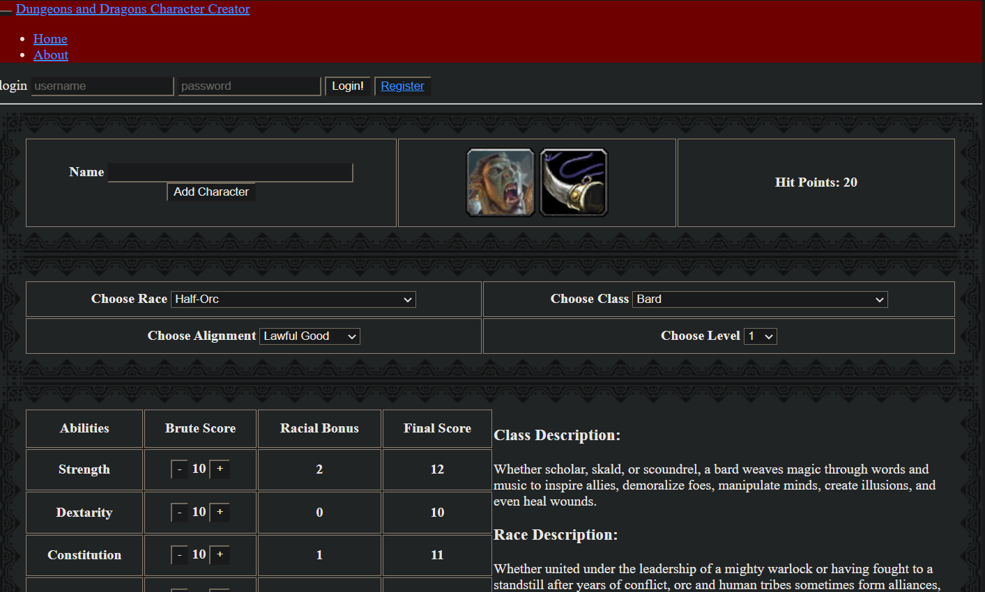
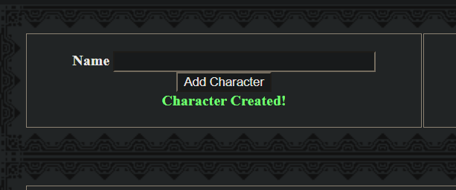
Let’s Run a Demonstration!

